Slide 1
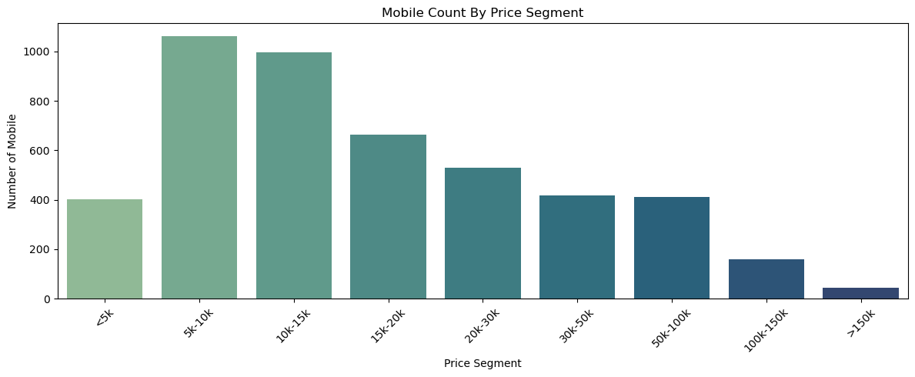
Que. 1. WHAT ARE THE DIFFERENT PRICE RANGE SEGMENTS FOR MOBILES IN INDIA ?
Answer :
Bar plot shows the Different Price Segments For Mobile in India

Slide 2
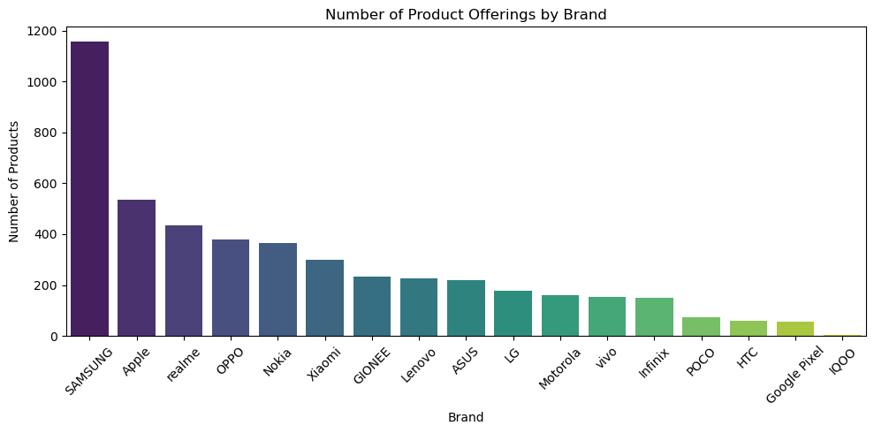
Que. 2. Which Brand Provides the Most Product Offerings in the Indian Market ?
Answer :
Bar plot shows That "SAMSUNG",
"Apple","realme","OPPO","Nokia", etc are the top Brands that Provide the Most Product Offerings in Indian Market.

Slide 3
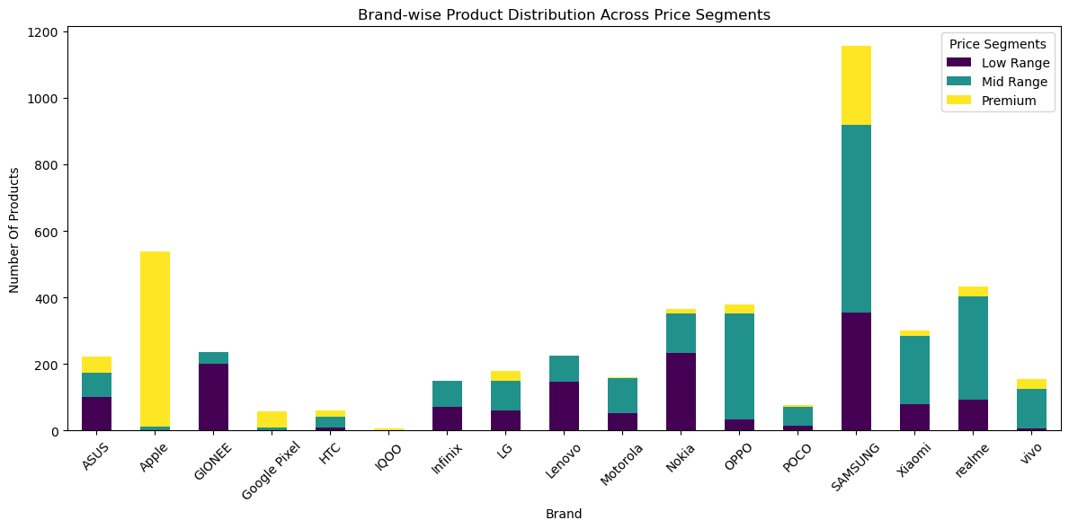
Que.3. Which Brand caters to all different segments ? (low range, mid range, premium)
Answer :
plot shows that 'ASUS', 'HTC', 'LG', 'Motorola', 'Nokia', 'OPPO', 'POCO', 'SAMSUNG', 'Xiaomi', 'realme', 'vivo' these are the Brands Caters to all the different Segments.

Slide 4
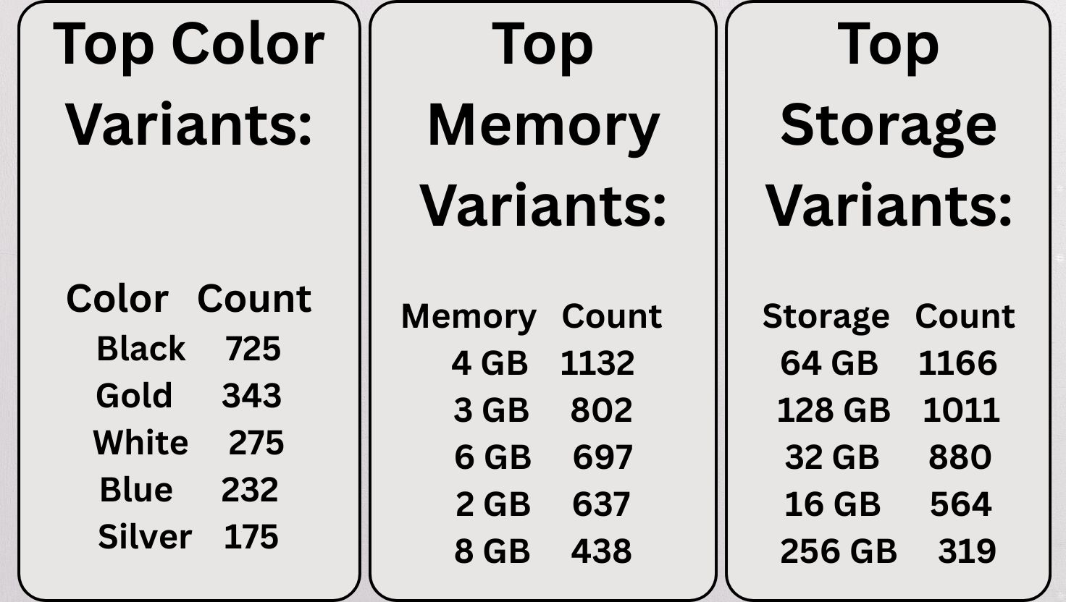
Que.4. What Specifications are the Most Common that are Offered by Various Brands
Answer :
Image to the side Shows the Most Common Specifications

Slide 5
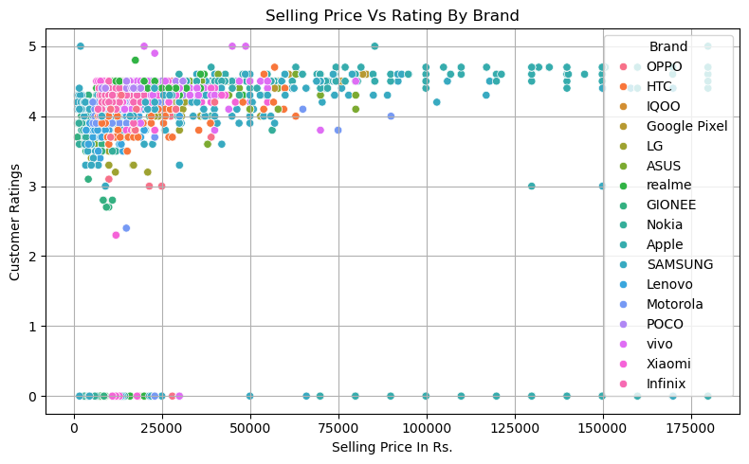
Que.5. Provide More Detailed Insights based on data provided
Answer :
1.Price vs Rating Analysis-
Under Rs.75000/- , we have a greater number of rating given and maximum are between 4 to 5.

Slide 6
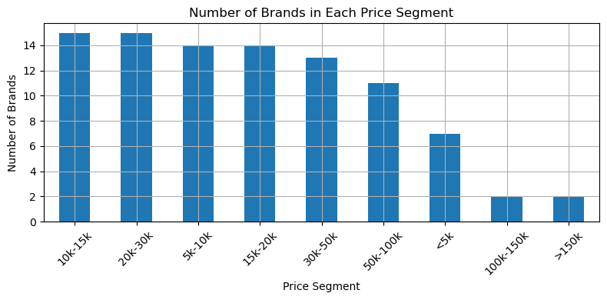
Que.5. Provide More Detailed Insights based on data provided
Answer :
2) Most Competetive Segment :-
Top 2 Price Segments are "10k-20k" & "20k-30k"

Slide 7
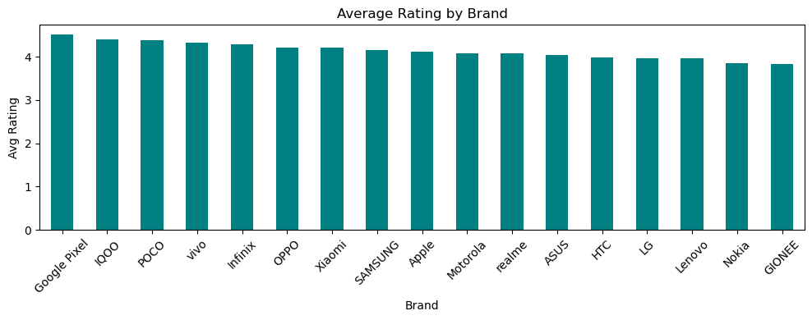
Que.5. Provide More Detailed Insights based on data provided
Answer :
Brand vs Average Rating :-
Average Rating is almost same for all the Brands in Mobile Market

Slide 8
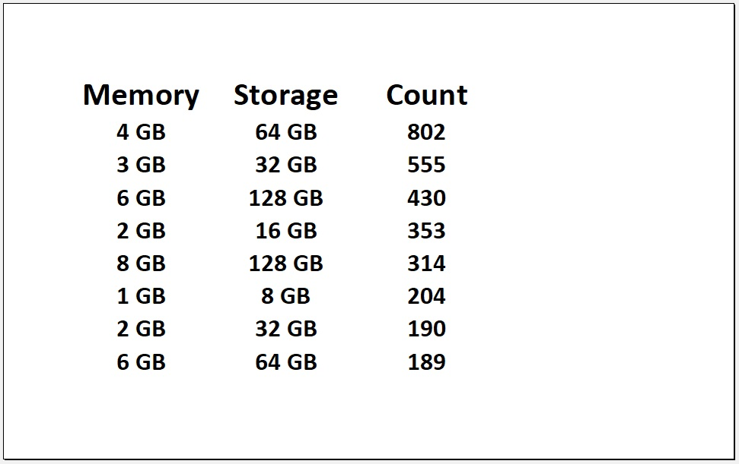
Que.5. Provide More Detailed Insights based on data provided
Answer :
Memory & Storage combos :-
Top Combos are (Memory/Storage) = 4GB/64GB , 3GB/32GB, 6GB/128GB

